Slide 1
Swin Transformer: Hierarchical Vision Transformer using Shifted Windows

Slide 2
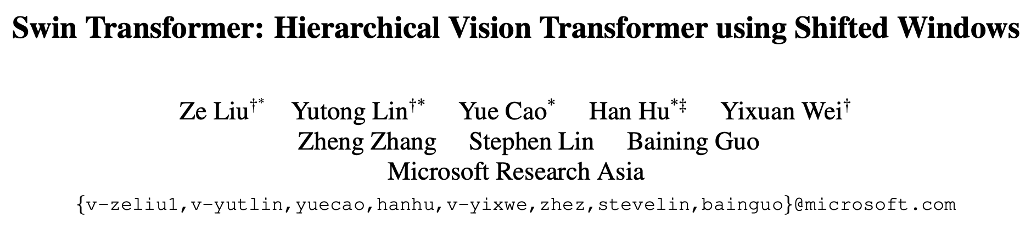
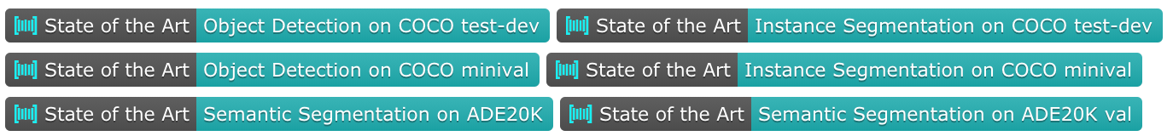
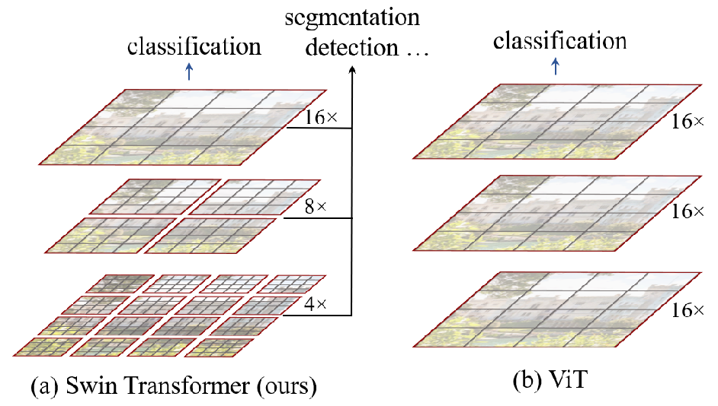

Slide 3
Background
Challenges in adapting Transformer from language to vision arise from differences between the two domains.
large variations in the scale of visual entities
the high resolution of pixels in images
a

Slide 4
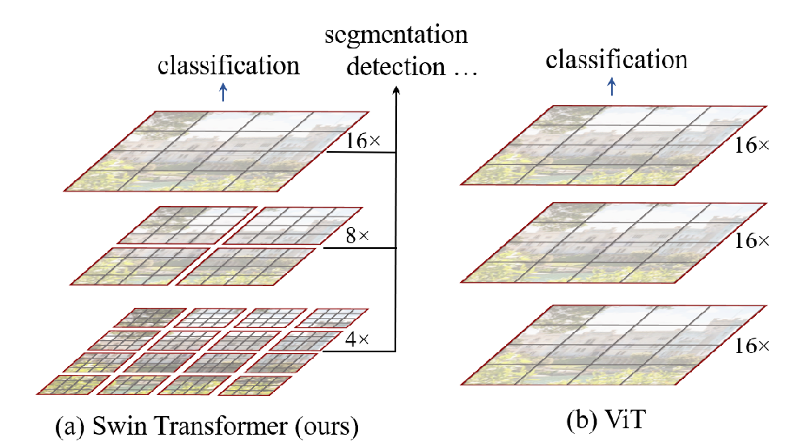
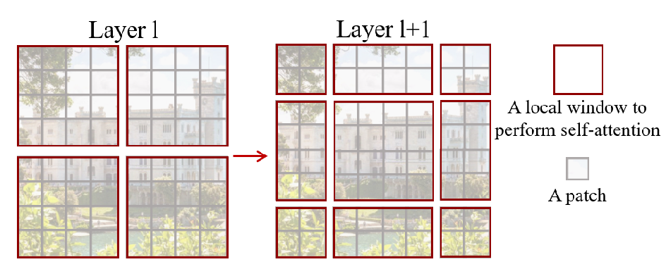
Method

Slide 5
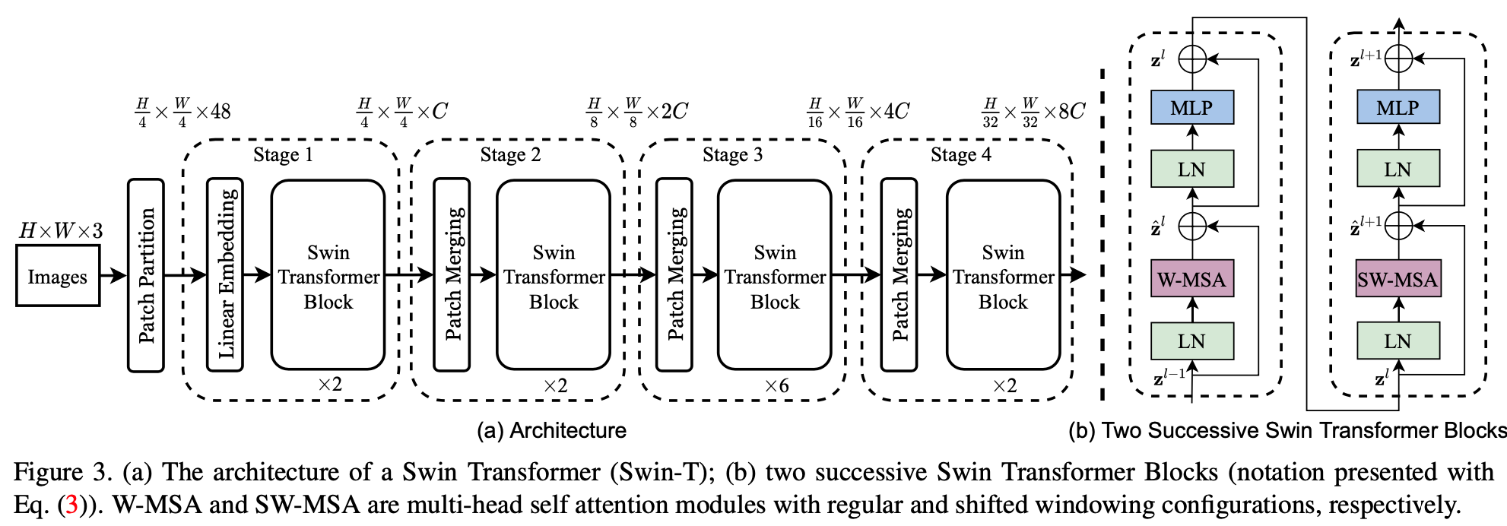
Method

Slide 6
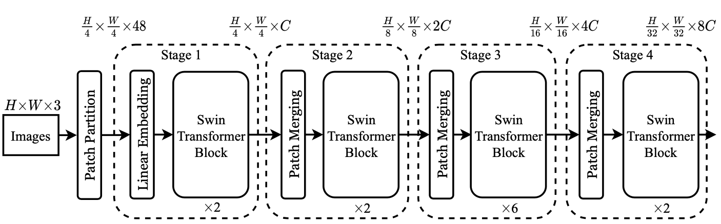
Method
Linear Embedding:
Patch Merging:
1 layer CNN
Split + Concat + Norm + Dense
Kernel size=Patch size=stride
Patch size=4

Slide 7
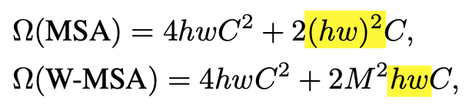
Method
Why W-MSA(masked self-attention)

Slide 8
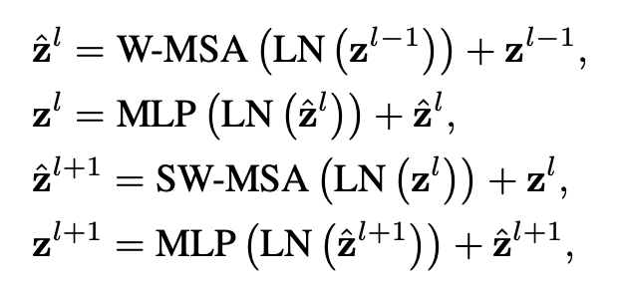
Method
Window shift

Slide 9
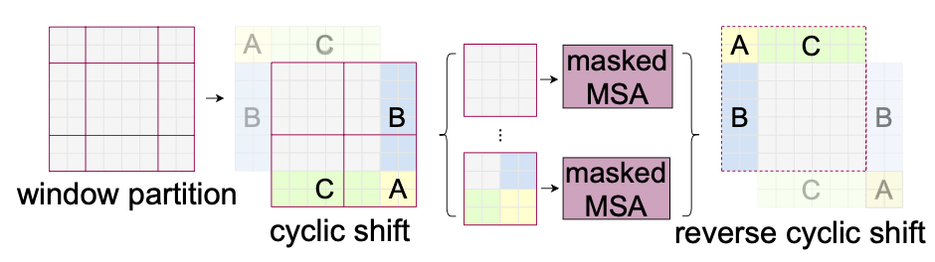
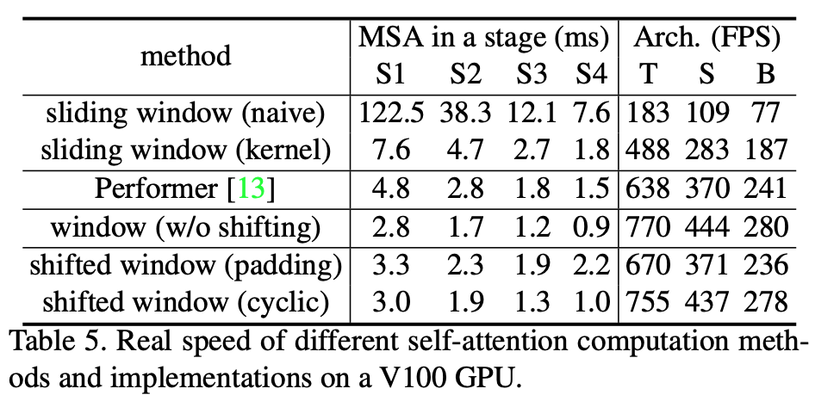
Method
Efficient batch computation for shifted configuration

Slide 10
Method
Relative Position Bias

Slide 11
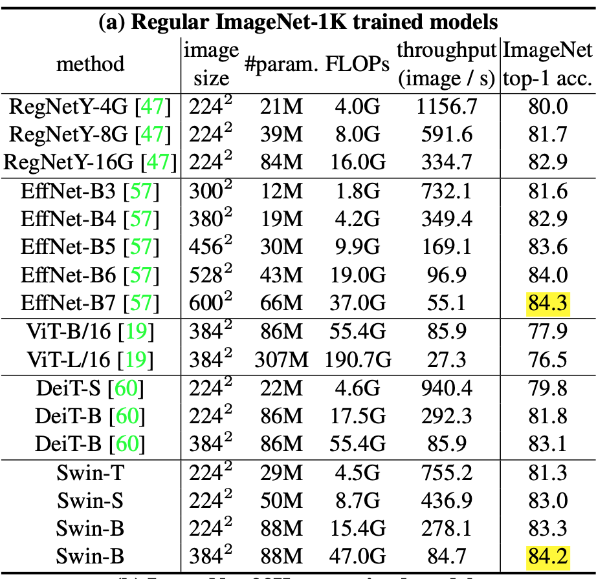
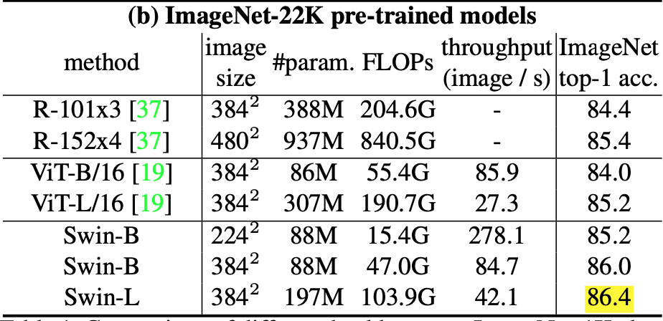
Experiments

